Slide 1
OLIST KAGGLE DATASET
Predicting Customer Churn in E-Commerce
A retention strategy analyzing 100,000 public marketplace orders.

Slide 2
Exploratory Analysis
High Demand Categories
Significant price variability across the platform.
Household, beauty, and electronic products dominated sales.
>50%
Low Demand Categories
Books, media, and food categories significantly lagged.
Orders with freight-to-price ratio above 20%.

Slide 3
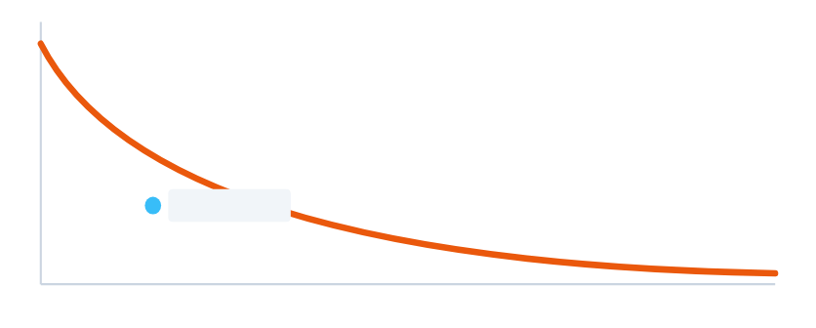
Customer Repurchase Decay Curve
Steep drop-off in repeat purchases over time. Inflexion point located between 90 and 200 days.
Repeat Purchases
90-200 Days
Days Since First Purchase

Slide 4


The Two-Window Churn Definition
Observation Window
Prediction Window
Track customer activity for $N$ days.
Monitor subsequent $N$ days for repeat purchases.
Strict 90-day threshold selected to effectively reduce data noise.

Slide 5
Data Preparation Pipeline
Imputation
Feature Engineering
Categorical Encoding
Null values replaced with zero or 'unknown'.
Freight ratios, delivery delays, and state income.
One-hot encoding using drop_first for multicollinearity.

Slide 6


90-Day Model Outcomes
Evaluated XGBoost, Random Forest, Decision Tree, and Logistic Regression.
XGBoost Performance Highest test accuracy, yet low F1 generalization.
Tree Models Tuned depth/estimators, still overfit heavily.
Logistic Regression Robust penalty applied; lowest overall performance.
Conclusion Severe overfitting and multicollinearity across all algorithms.

Slide 7



Actionable Business Strategies
Logistics Optimization
Strategic Bundling
Future Data Strategy
Pack small products with large ones to leverage freight economies of scale.
Promote least-selling categories by bundling them with high-demand items.
Include behaviour-based features like session time for better explainability.

Slide 8
Questions & Discussion
Thank you for your time.

